Slide 1
MACHINE LEARNING
ALGORITHMS
Linear Classification using
Logistic Regression and Feature Selection Method
ITMLA2-B44

Slide 2
Contents Covered
Discuss the logistic regression algorithm
Implement logistic regression algorithms using stochastic gradient descent
Understand the pertinence of feature selection methods in machine learning
Demonstrate proficiency in commonly used effective feature selection methods

Slide 3
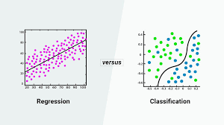
Logistic Regression
In the first week, it was explained that classification is the process of identifying to which class among a fixed number of classes a given input feature vector belong. Unlike, regression, classification is a supervised learning algorithm in which the output variable is categorical rather than continuous.
Classification in a nutshell aims to determine through proper parameter estimation, a probability density function that determines the likelihood of a feature set to belong to some class, in other terms, the conditional probability of an event to occur:

Slide 4

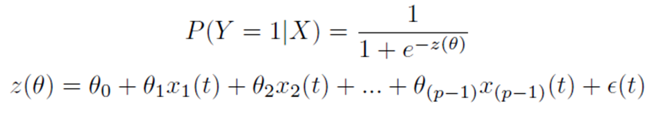
The class with the highest probability of belongingness will be the class in which the record belongs to. The most basic type of classification is binary classification, which discriminates between two classes rather than several classes.
E.g Identifying whether someone has malaria or not or whether a mail is a spam or not. Moreover, in the classification family, nonlinear and linear classification algorithms can be distinguished based on the assumption made of the mapping function of the input feature vector.
Logistic regression is a binary classification that makes the assumption that the conditional probability distribution of the feature vector is function of a linear combination of the feature applied to a sigmoid function:

Slide 5
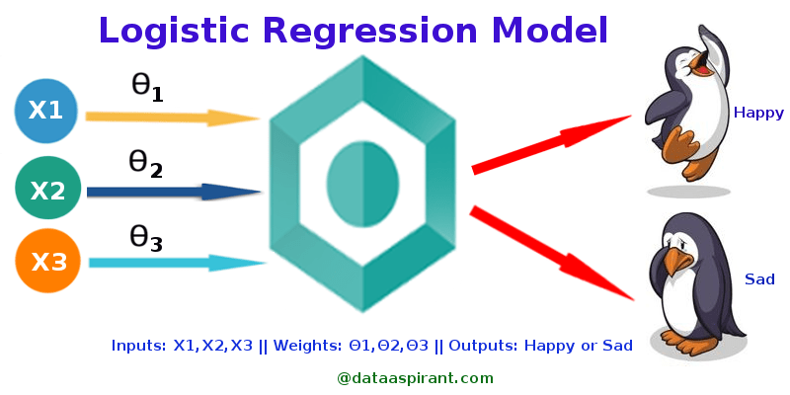
Types of Logistic Regression
Binary Logistic Regression
The categorical response has only two 2 possible outcomes. Example: Spam or Not
Multinomial Logistic Regression
Three or more categories without ordering. Example: Predicting which food is preferred more (Veg, Non-Veg, Vegan)
Ordinal Logistic Regression
Three or more categories with ordering. Example: Movie rating from 1 to 5

Slide 6
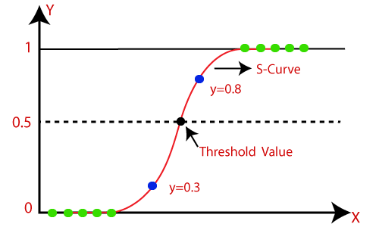
Logistic Regression is much similar to Linear Regression except that how they are used. Linear Regression is used for solving Regression problems, whereas Logistic regression is used for solving the classification problems.
In Logistic regression, instead of fitting a regression line, we fit an "S" shaped logistic function, which predicts two maximum values (0 or 1).
The curve from the logistic function indicates the likelihood of something such as whether the cells are cancerous or not, whether a mouse is obese or not based on its weight, etc.

Slide 7
A probability is returned using logistic regression. You may utilize the returned chance “as is” or convert it to a number that is binary.
A logistic regression machine learning model with a result of 0.9898 predicts that an email is extremely likely to be spam. Another message (email) with a score of 0.0002 on the same regression ML model, on the other hand, is almost certainly not spam. But how about an email with a 0.6843 prediction score?
A classification threshold value must be defined if you want to transfer a logistic regression value to a binary category. A value greater than that denotes “spam,” whereas a value less than that suggests “not spam.” It’s easy to assume that the classification threshold is always going to be 0.5… however, machine learning thresholds are problem-specific and must be fine-tuned.
LOGISTIC FUNCTION (SIGMOID FUNCTION):
The sigmoid function is a mathematical function used to map the predicted values to probabilities.
It maps any real value into another value within a range of 0 and 1.
The value of the logistic regression must be between 0 and 1, which cannot go beyond this limit, so it forms a curve like the "S" form. The S-form curve is called the Sigmoid function or the logistic function.

Slide 8
In logistic regression, we use the concept of the threshold value, which defines the probability of either 0 or 1. Such as values above the threshold value tend to 1, and a value below the threshold value tends to be 0.
ASSUMPTIONS FOR LOGISTIC REGRESSION:
The dependent variable must be categorical in nature.
The independent variable should not have multi-collinearity (when there are high correlations between two or more predictor variables).

Slide 9
Unlike, linear regression, logistic regression is not trained using the sum square errors. The algorithm is trained by finding the parameters that maximise the probability for all data. This algorithm is called the Maximum Likelihood Estimation (MLE).
Being a binary classifier, with two outcomes, the output of logistic regression can be modelled as a Bernoulli random variable, and thus the probability mass function of the Bernoulli distribution can be used:
The Bernoulli distribution is a discrete probability distribution that covers a case where an event will have a binary outcome as either a 0 or 1.
x in {0, 1}

Slide 10
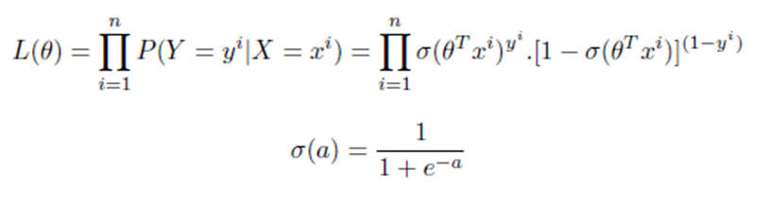

Using the probability mass function of a single data point, the conditional likelihood of all the data can be constructed where each a data point is independent:
For the purpose of computation, this probability is converted into an equivalent logarithmic form, yielding
which will thus be maximised to find the optimisation parameter. In the the same vein as least regression, partial derivatives of the cost function should be computed to undergo an interactive optimisation process using the gradient descent algorithm and similar variants.

Slide 11
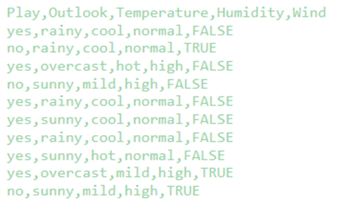
PYTHON IMPLEMENTATION
Using a dataset ("golf_session.csv") of a team that has been playing golf for a couple of sessions. Make use of Naïve Bayes to decipher underlying conditions based on which the team decide to play.

Slide 12
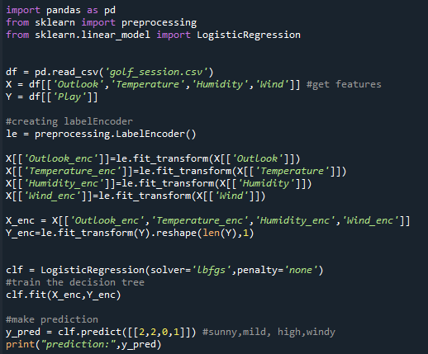

Slide 13
Feature Selection
Models

Slide 14
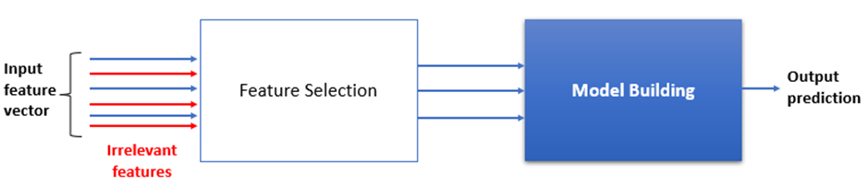
In the previous lessons, we learned that machine learning algorithms create a mapping relationship between the input feature vector and the output response variable, typically in the case of supervised learning methods. However, it is worth noting that all features in the initial feature vector are relevant to the prediction of the output response. Some features are relevant to predicting the final output and therefore need to be eliminated. This process is referred to as feature selection.
Feature selection is the process of reducing the number of input variables when developing a predictive model.
Two big families of feature selection methods can be distinguished:
Filter-based Methods:
Wrapper-based methods:

Slide 15
While developing the machine learning model, only a few variables in the dataset are useful for building the model, and the rest features are either redundant or irrelevant. If we input the dataset with all these redundant and irrelevant features, it may negatively impact and reduce the overall performance and accuracy of the model. Hence it is very important to identify and select the most appropriate features from the data and remove the irrelevant or less important features, which is done with the help of feature selection in machine learning. (Javapoint)
Feature selection is desirable to reduce the number of input variables to both reduce the computational cost of modelling and, in some cases, to improve the performance of the model.
Statistical-based feature selection methods involve evaluating the relationship between each input variable and the target variable using statistics and selecting those input variables that have the strongest relationship with the target variable. These methods can be fast and effective, although the choice of statistical measures depends on the data type of both the input and output variables.

Slide 16
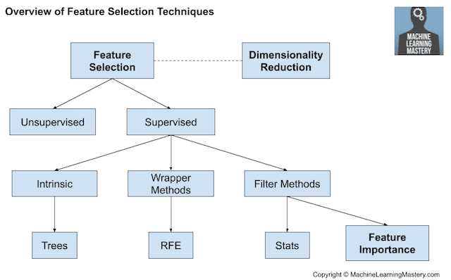
RFE: Recursive Feature Elimination
Benefits of using feature selection in machine learning:
It helps in avoiding the curse of dimensionality.
It helps in the simplification of the model so that it can be easily interpreted by the researchers.
It reduces the training time.
It reduces overfitting and hence enhances the generalization. (Javapoint)

Slide 17
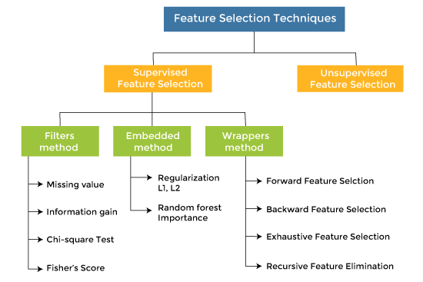
FEATURE SELECTION TECHNIQUE
There are mainly two types of Feature Selection techniques, which are:
Supervised Feature Selection technique Supervised Feature selection techniques consider the target variable and can be used for the labelled dataset.
Unsupervised Feature Selection technique Unsupervised Feature selection techniques ignore the target variable and can be used for the unlabelled dataset.

Slide 18


Wrapped Based Methods
In wrapper-based methods, the model is retraining several times using different feature vector combinations. The training and forecasting performance of each feature vector combination is kept in memory. The feature vector combination that yields the highest training and forecasting score is normally selected as the feature vector for the model. Other remaining attributes are disregarded.
For example, in a set of 3 features:
There are 3! = 6 possible independent combinations of features:
A wrapper method will typically, train the model with each independent feature combination and select the highest performant combination.

Slide 19
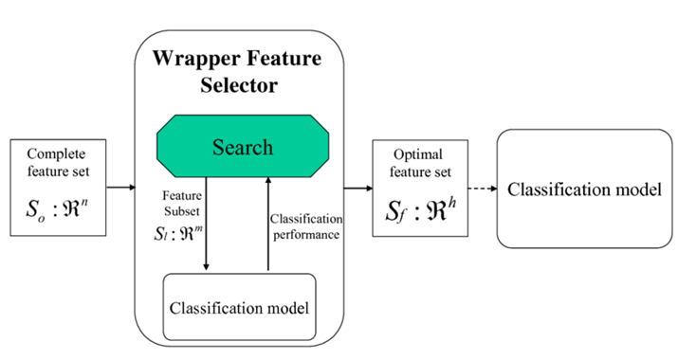
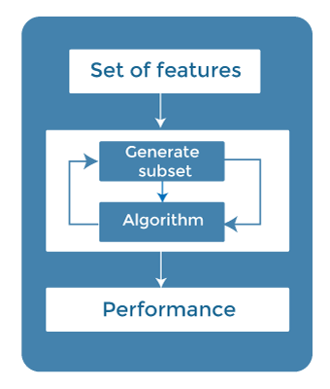
The main advantage of the wrapper-based is
its great accuracy in selecting the most pertinent feature set for the final model. However, considering that the feature vector size can be large size, using the wrapper-based method is very computationally expensive.
A mitigation strategy would be to use heuristic selection approaches of input feature combinations that can help provide decent performance without exhaustively searching through all the existing combinations. Algorithms like the Genetic Algorithm are not generally reducing the computation demand when using wrapped-based methods.

Slide 20
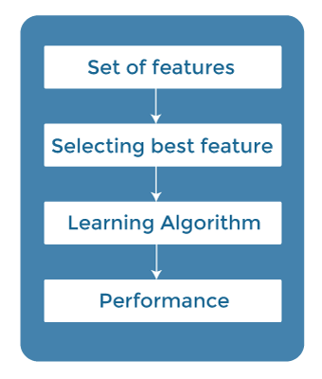
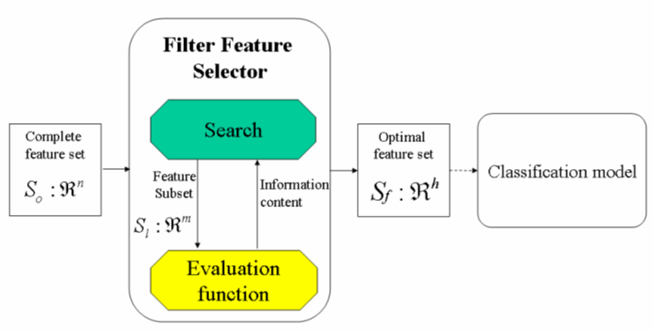
Filter Based Methods
Unlike wrapper-based methods, feature-based methods do not make use of the machine learning model when searching for the optimal feature set. A ranking algorithm is used to analyse the contribution of each feature individually to the final outcome by looking at its information content using statistical methods or feature importance methods.

Slide 21
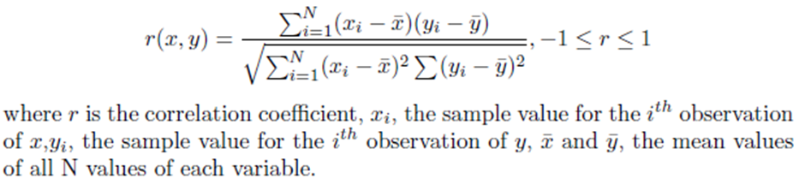
Typically filter scores used when suggesting the information content of a feature input are:
PEARSON CORRELATION
The Pearson correlation coefficient evaluates the linear dependency between two continuous variables on a scale ranging between -1 to 1 or using an absolute estimate between 0 to 1. When a variable varies in proportion to another, technically the correlation measure will be either positively increasing or negatively decreasing depending on the nature of the dependency. Pearson correlation is often to rank continuous features against continuous target outputs:

Slide 22

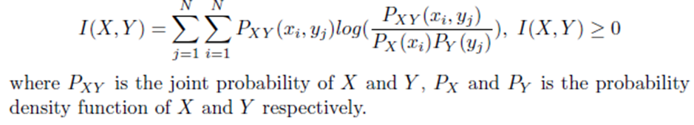
When ranking each feature, the square of the correlation coefficient is often used as the direction of correlation is not so consequential.
INFORMATION GAIN AND MUTUAL INFORMATION
Mutual information is a dependency score that aims to assess the amount of information one variable has about another variable using a probabilistic formulation. It is often used to assess the dependence between continuous variables making no assumption of linearity as for the correlation measure:
The greater the value of mutual information, the higher the dependency between the two variables.

Slide 23
CHI-SQUARE TEST
The Chi-square is a statistical test that can be used to test if two categorical variables relate to each other.
The Chi-square test is a technique to determine the relationship between the categorical variables. The chi-square value is calculated between each feature and the target variable, and the desired number of features with the best chi-square value is selected.

Slide 24
THANK YOU

